Slide 1
Idea/Approach Details Ministry/ Organization name: Department of IT & Cyber Security, DRDO Problem Code: CK48 Technology Bucket : Hardware Sensors and SOS facility attached to microcontroller which are controlled and maintained via Internet of Things along with enhanced secur Problem Statement : Soldier Strap Team Name: TechMakers505 Team Leader Name: Jagrati Category : Hardware College Code: 1-3513231070

Slide 2
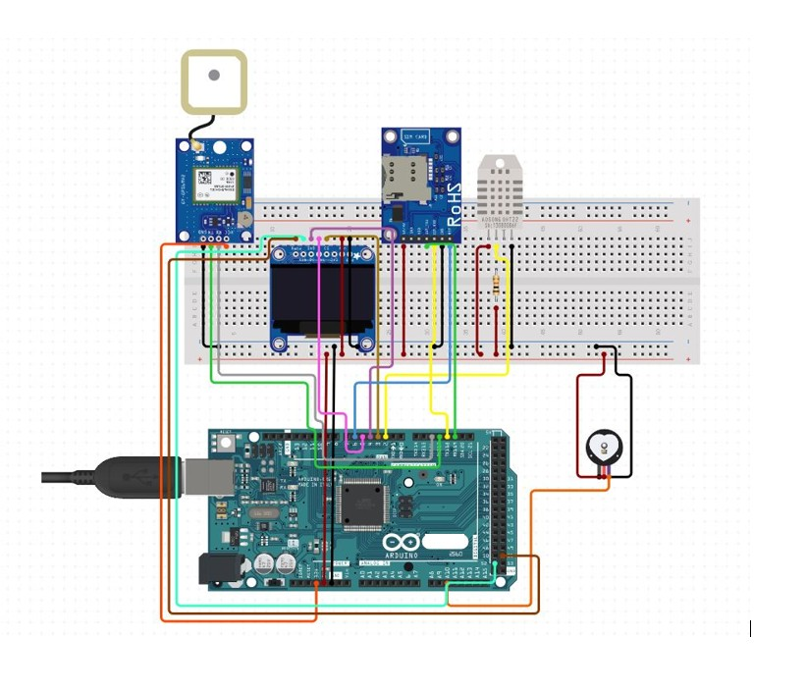
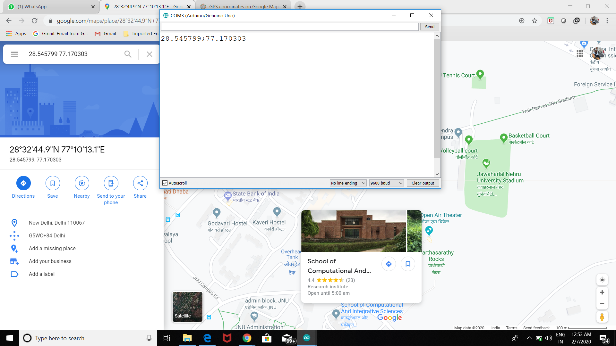
Idea / Approach details
Describe your idea/ Solution / Prototype here
For measuring the basic body parameters,varied sensors are attached with the strap which will be across the body of the soldier. IOT along with Bluetooth ELectronics Application is used for this purpose which will keep on simalteneously sending live data to the staelite where the data will be telecated to the Control Base Station.
For SOS facility, GSM mode of communication is provided along with a GPS module to track the exact location of where the signals are coming from,such that the soldier can communicate with the public in case of emergency.
For ensuring secured data transmission and receiving, Zigbee module will be used which is not only self configuring but also performs cryptography at the backend along with confirming digital signatures.Also to enhance the range of communication,hybrid topology will be used.
All the Zigbee user's locations are tracked at the Base Station as a result of which, the no. of counts at the Field is tracked and a rely will be sent to both the Base Station and the peer soldier.
Technology Stack
Heart rate Sensor- Monitoring pulse rate and also breathing rate of the soldier.
PD Lithium Polymer battery- Long lasting(3.5V, rechargeable),light weight.
SOS Facility- The Micro-controller will be configured so that on pressing a button, a specialized program will run at the base station warning about danger.
Cloud Storage- For storing the sensors outputs.
Bluetooth Electronics Application - For configuring the Receiver and Transmitter nodes in the Micro controller to the Bluetooth 0 1 bits.
Temperature Sensor - For predicting any abnormal rise or fall in the soldier’s body temperature.
GSM Sim9001a Module- Establishes a communication portal for the soldier with the control base.
Zigbee Module- For securing the communication modes.
Textile based flexible PCB- will be used so as to fabricate the components.
Circuit diagram of the prototype
Screenshot of the live location tracked

Slide 3
Idea / Approach details
Use Case
Dependencies
Showstopper
For estabilishing the secured communication, which will be live telecasted to the base stationGSM Module, along with Zigbee is needed
For finding the location(latidudinal and longitudinal measurements),GPS module is needed.
Cloud Storage is necessary for storing all the sensor outputs.
For storing all the codes in the microcontroller, a bluethooth Electronics Application is used.
All the sensors and the modules which will be conneted to the microcontroller needs to be power effecient .
Flexible PCB textile is needed to fit all these components and hence make it compact and portable.
As armed forces are one of the most difficult services,technology should play its role to provide all kind of support needed.
Usually when a soldier is in battle ground, he is all alone. However with this soldier strap, each and every soldiers activity and health conditions are measured along with providing a secured end to end encrypted SOS communication.

